Slide 2
The SoftMotion Drive Interface Controlling 3rd Party Motion Drives with LabVIEW and NI Real-Time Controllers
Zach Jones
Product Manager
Motion Control
Notes:
This presentation provides and overview of the LabVIEW SoftMotion module Drive Interface (SDI) feature.
An SDI provides the hooks and framework necessary to interface a smart motion drive with a LabVIEW Real-Time controller (PXI, CompactRIO, etc…) over a digital bus interface. The initial release is limited to the EtherCAT Ethernet fieldbus. Other industrial Ethernet based buses may become available in future releases of SoftMotion but are not supported at this time.

Slide 3
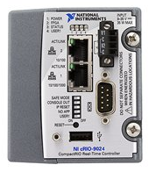
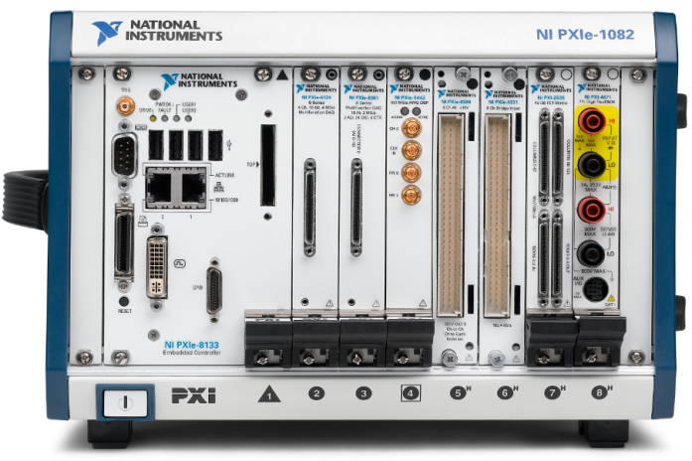
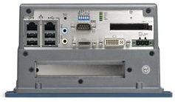
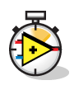
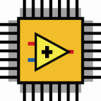

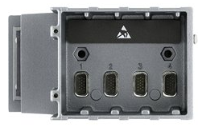
Motion System Overview
Master Options: Any RT Controller w/ two Ethernet Ports
Industrial Ethernet fieldbus connectivity
Distributed & Synchronized
Simple and flexible
Easy expansion with additional drives or I/O
EtherCAT Master (CompactRIO shown)
EtherCAT Servo Drive/Motor
EtherCAT Servo Drive/Motor
EtherCAT Servo Drive/Motor
(EtherCAT)
Notes:
This diagram shows a typical motion system including smart drives. The drives must talk back to a motion controller for high level position (or velocity or torque) commands. The motion control handles trajectory generation, including multi-axis coordination and control (multi-input multi-output control, MIMO, is sometimes mentioned). The motion controller must also handle communication with I/O and supervisory control systems.
The motion controller and drives could come from a single vendor but often drives are sold as component products which are integrated with a motion controller (PLC, PAC) from another company to build a machine.
In the NI case, we add motion controller capabilities to our general purpose CompactRIO and PXI controllers when we install the LabVIEW SoftMotion module on them. SoftMotion enable to the control of a wide variety of motion hardware including C series drives and drive interfaces as well as AKD EtherCAT drives (which NI resells from our drive vendor product partner Kollmorgen).
There are many drive vendors out there with different capabilities. We want to make it as easy as possible for a machine builder to design, program, and commission a system with NI controllers and their particular drive/motor choice.
For those not familiar with

Slide 4
Desired Motion System Overview
Master Options: Any RT Controller w/ two Ethernet Ports
Industrial Ethernet fieldbus connectivity
Distributed & Synchronized
Simple and flexible
Easy expansion with additional drives or I/O
EtherCAT Master (CompactRIO shown)
Servodrive
Vendor X
Servodrive
Vendor Y
Servodrive
Vendor Z
(EtherCAT)
Notes:
There are many drive vendors out there with different capabilities. We want to make it as easy as possible for a machine builder to design, program, and commission a system with NI controllers and their particular drive/motor choice.
The SoftMotion Servo Drive Interface functionality makes it possible for drive vendors to develop and maintain plug-ins that allow their drives to work seamlessly with an NI Controller (EtherCAT master) and SoftMotion API/engine over EtherCAT.

Slide 5
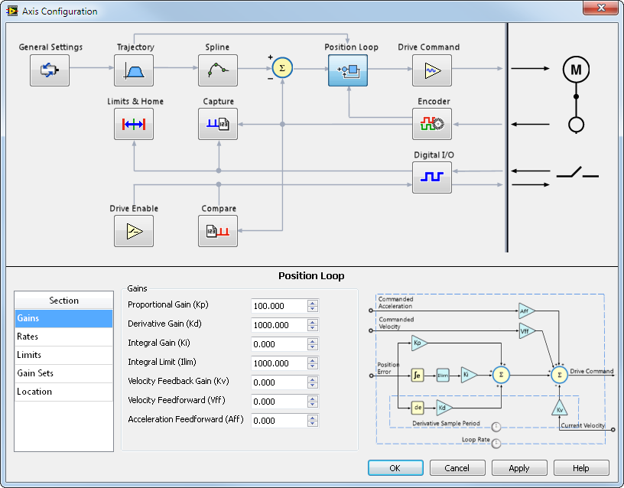
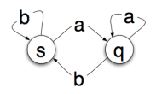

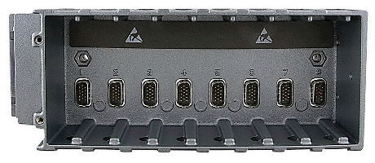
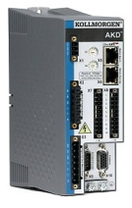
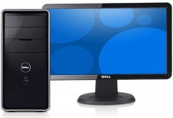
SoftMotion and the LabVIEW RIO Architecture
Motion
User Program
Supervisory Control
Trajectory Generator
Interpolation
Position Loop
Velocity Loop
Torque Loop
Motion I/O
1-100 kHz
4-100 kHz
20-100 kHz
PC
Real-Time Controller
User Programmable FPGA
Motion Drive
Other Machine Subsystems and Capabilities
HMI
Machine Vision
Data Acquisition
Process Control
Control Design and Simulation
Filtering and Signal Processing
Notes:
The LabVIEW SoftMotion Module is NI’s approach to motion control. It adds motion controller functionality to an NI Real-Time controller. The strengths of this approach include the flexibility of the motion implementation, inherent timing and synchronization with a wide variety of high performance customizable I/O, and tight integration with all the other capabilities of the NI control platform.
Originally, this slide had many arrows pointing to the locations that each motion subsystem could be run. The combination of SoftMotion and our RIO architecture offers customization all the way down to the I/O pins, logic gates, and clock sources.

Slide 6

NI LabVIEW SoftMotion Module
NI SoftMotion Module
User Code
SoftMotion Engine
Motion Drive
APIs
SoftMotion Drive Interface
Notes:
The LabVIEW SoftMotion Module consists of
A high level API for building motion applications in LabVIEW
A motion engine to handle deterministic tasks, trajectory generation, and motion controller functionality
Multiple Extensions to motion hardware
we inherit the flexibility and scalability that LabVIEW provides. (as well as integration with sensors, vision, web services, etc…)
See the following NI Week session the Motion R&D team created for a great in-depth view on the power of SoftMotion.
SoftMotion Under the Hood NI-Week 2010
http://nitalk.natinst.com/docs/DOC-7363

Slide 7
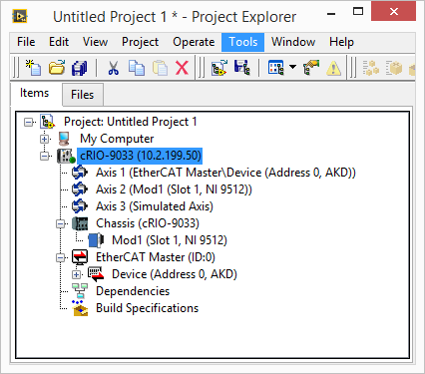
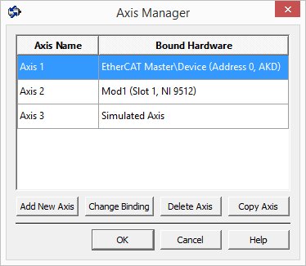
SoftMotion Axes
Notes:
In SoftMotion, code re-use is made easy. A virtual axis can be bound to simulated hardware for testing, then re-bound to actual hardware for use.

Slide 8
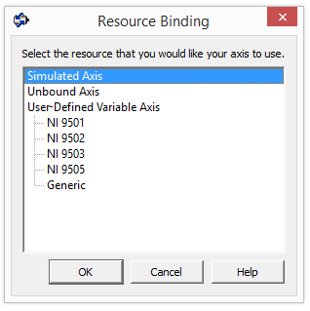
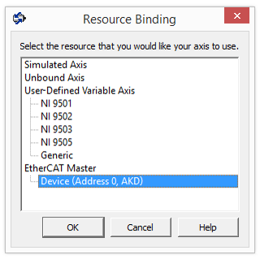
SoftMotion Axes
Notes:
A SDI Plug-in drive will show up as a resource under the EtherCAT Master. We can bind an axis to it easily and it becomes part of our LabVIEW project.

Slide 9
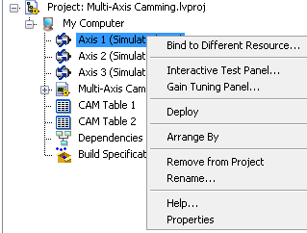
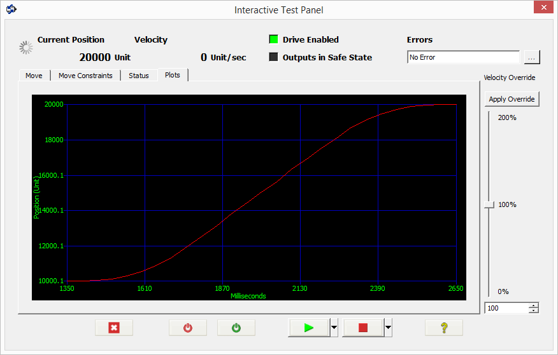
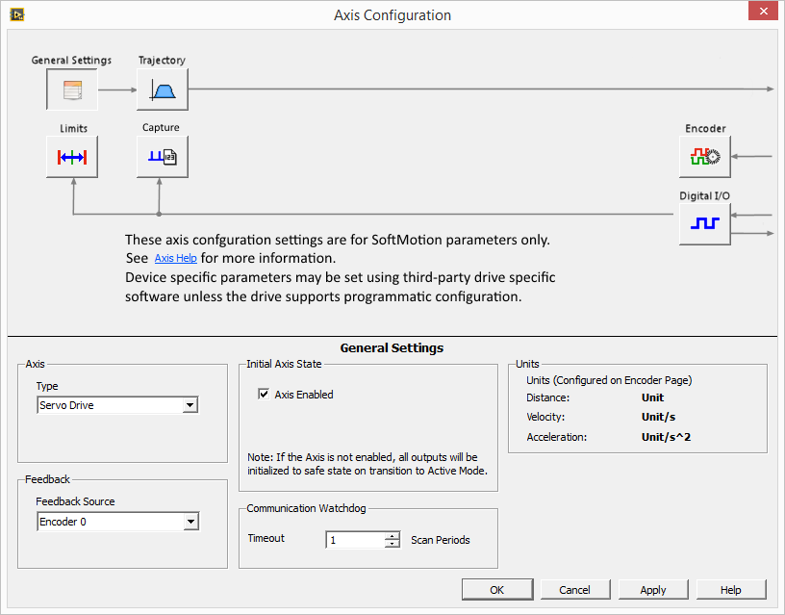
SoftMotion Configuration and Testing
Notes:
By integrating an EtherCAT drive into SoftMotion, advantages such as interactive test panels and SoftMotion Axis Configuration are gained. This allows for high-level customization of a motion axis instead of low-level PDO/SDO communication. It also allows for a familiar interface to the axis that NI SoftMotion customers are comfortable with.

Slide 10
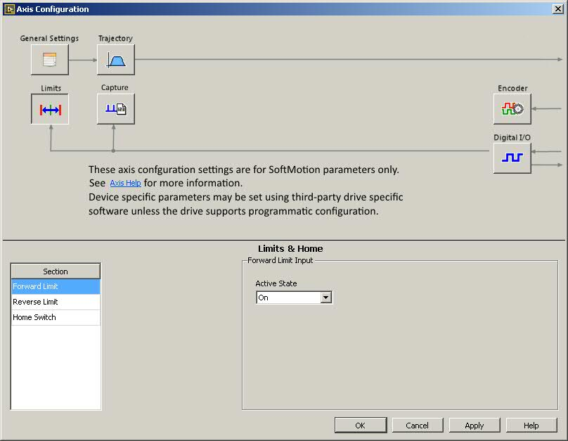
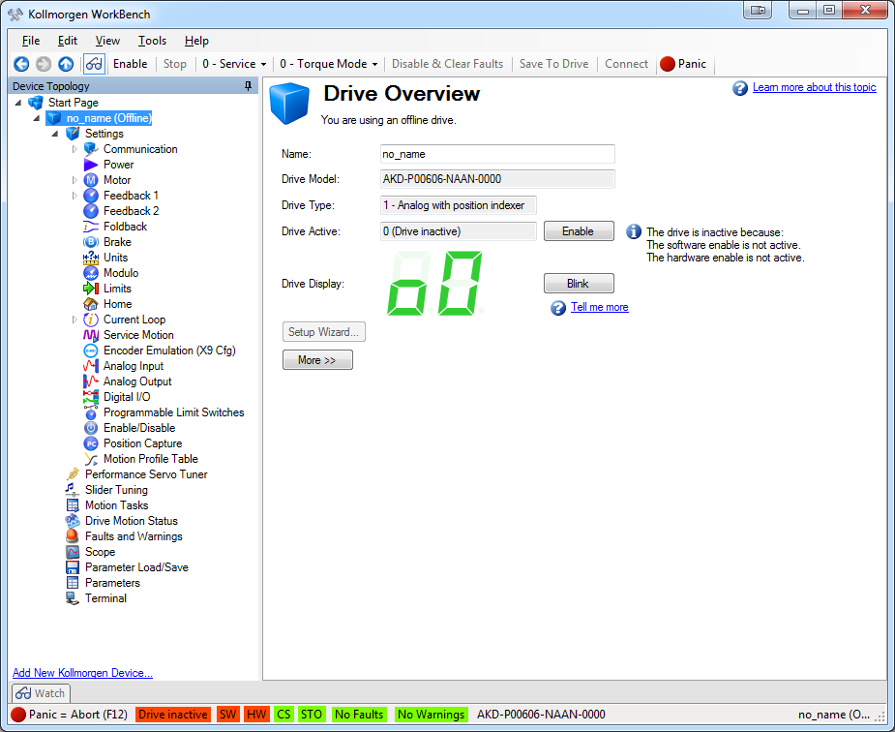
Configuring a SoftMotion Drive Plug-in Axis
Axis Settings
Drive Settings
Notes:
Because we recognize that our partners have software specifically customized for their drives, the SoftMotion axis configuration presents a SoftMotion-specific set of options to configure behavior. Motor tuning and other options are best handled by the drive vendor configuration software. Customers that prefer to use a drive from a specific vendor tend to prefer the configuration software from that vendor as well.
On the right is an example of drive configuration software. This is where the customer will do most of the configuration of the drive. After configuration, the customer can save the current set of parameters as the defaults so the settings persist through a reboot.

Slide 11
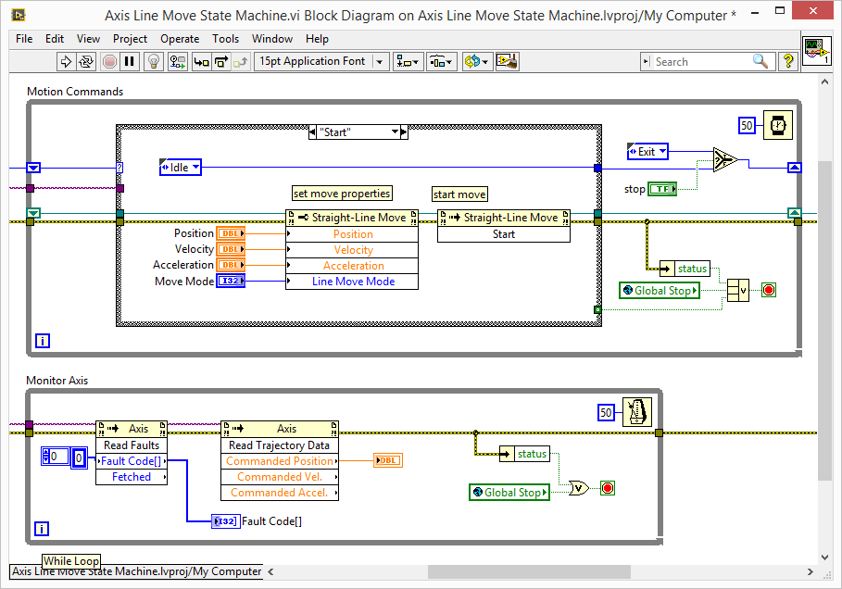
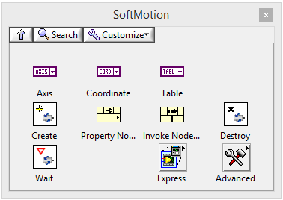
LabVIEW SoftMotion User Code
Notes:
This is sample SoftMotion code for a Straight Line Move. This was written in about 10 minutes and provides a user interface to monitor the position of the motor as it moves. There are many example projects in LabVIEW that show more complex functionality.
The SDI axis can be programmed the exact same as any other motion axis. It can use this code.

Slide 12
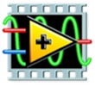
SoftMotion Drive Interface architecture
SoftMotion Drive Interface
LabVIEW
Framework
NI EtherCAT
Motion Drive
SoftMotion Engine
Plug-in
Notes:
Here is a high level architectural diagram. The blue pieces are provided by NI, the green pieces are not.
The SDI is split into two parts: Framework and Plug-in. The Framework was created and is maintained by the SoftMotion team. It completes PDO and state-machine communication for the developer.
Our SoftMotion team has also provided a LabVIEW project template for the Plug-in, which can be used by integrators or drive vendors to bring an EtherCAT drive into the LabVIEW ecosystem. The Plug-in exists to complete SDO communication with the drive from SoftMotion.
The default SDI Plug-in project template assumes compliance with the CANOpen DS402 profile. The Plug-in components are based on a LabVIEW class (similar to a C++ class in concept), allowing for overrides of default DS402 behavior when a drive has minor deviations from DS402. We have also documented the default PDO layout that the SDI framework assumes, and this can be modified if necessary.
If a drive perfectly compiles with the DS402 profile, the SDI Plug-in template will only require minor data entry to associate the Plug-in with the drive. Deviations from DS402 will require a time investment in development.

Slide 13
Technical Details

Slide 14
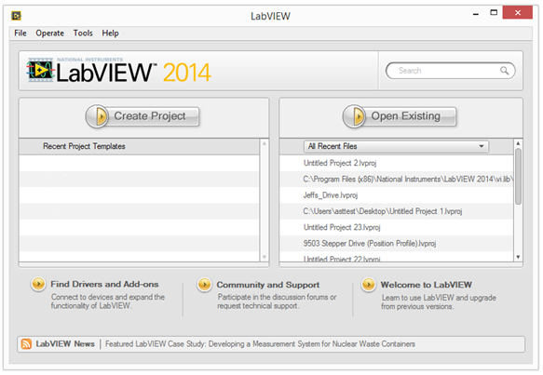
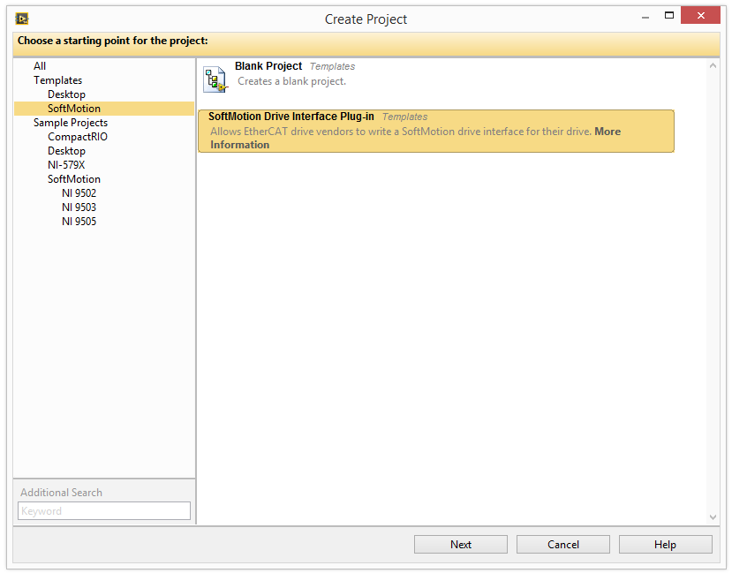
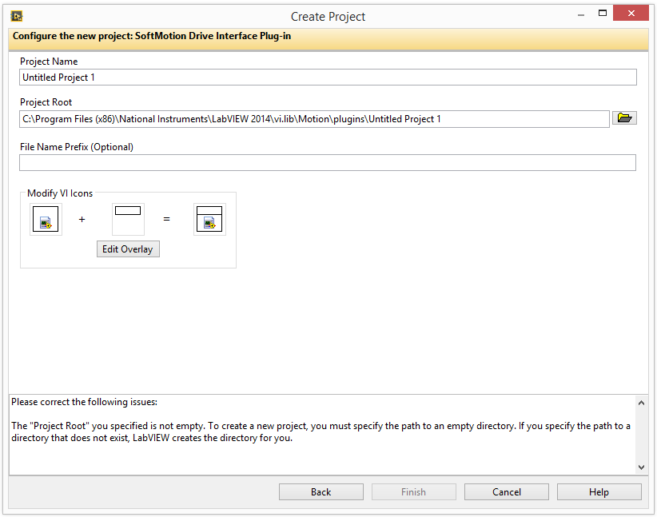
Creating a plug-in template
Full documentation
Notes:
To get started creating a plug-in go the LabVIEW launch screen and click on “Create Project”. In the next dialog you will see a SoftMotion item in the list on the left. Click on this and then “SoftMotion Drive Interface Plug-in” in the main window and click “Next.”
In the final window, name the project file and the location where it will be created. Optionally add a file name prefix and custom icons.
IMPORTANT: The plug-in needs to be in a uniquely named folder in “<LabVIEW>\2014\vi.lib\Motion\plugins\” for the SoftMotion framework to recognize it.
For Example: The plug-in files could be in the “<LabVIEW>\2014\vi.lib\Motion\plugins\<CompanyName>_<DriveName>” folder.

Slide 15
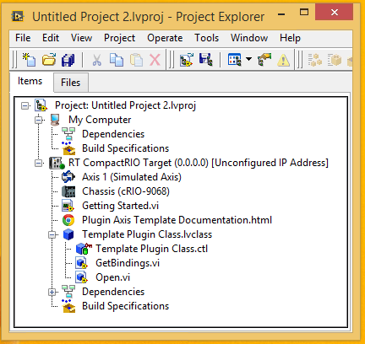
What the plug-in template provides
Notes:
This is what the generated template code looks like. There are three Vis, two contained in a class that implements the plug-in, and one for testing the plug-in.
Getting Started.vi – The sample VI for testing your plug-in. It shows how to initialize the plug-in from the user code and how to execute a straight-line move. Additional examples should also be created specific to your plug-in. This VI can be cleaned up and used as a simple straight line move example.
SoftMotion Drive Interface plug-in template documentation – This is the same document you see if you click on the “More Information” link in the Create Project wizard seen on the previous slide. It is linked here so you can find help whenever you need it.
Template Plug-in Class – LabVIEW class that implements the plug-in
Open.vi –This vi is to be called by the user at start of the program to create an instance of the plug-in and add the axis resource to it. This allows the plug-in to get needed information from SoftMotion. It should be included on a LV palette when installed to the customer’s computer.
GetBindings.vi – This VI informs SoftMotion of the drive’s vendor ID and device ID, which are required for SoftMotion to recognize the drive as an EtherCAT slave device. This VI should be updated as the first step in implementing the plug-in, and will allow SoftMotion axes to bind to the drive.
Plugin must be at a specific location.
Ex.“<LabVIEW>\vi.lib\Motion\plugins\<YourFolder>”

Slide 16
Default features supported by the template plug-in
Enabling/Disabling drive
Moves (Axis and Coordinate)
Cyclic Sync Position
Velocity Profile
Torque Profile
Clear fault
Read fault
Position capture (Touch Probe)
Digital IO
Notes:
A SoftMotion Drive Interface plug-in template already has support for these features. If the drive adheres closely to DS402, and the PDO mappings are correct (more on PDO mappings later), these features may “just work” once you update the GetBindings.vi.
Look for ‘#CodeNeeded’ in block diagram comments for required changes.
The plug-in can be customized as needed for deviations from DS 402, or to support additional features not listed here. We will briefly discuss how to extend the functionality of the plug in a few slides, but the documentation contains many of the technical details.

Slide 17
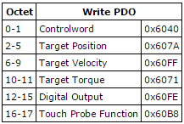
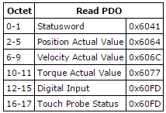
Template plug-in PDOs
The template plug-in assumes the following PDOs.
Modify for deviations from DS 402 or for additional features
Different PDOs require overriding Execute.vi (see documentation)
Notes:
The generated plug-in template assumes the PDOs are in the order shown in these templates. If you need to deviate from this, you will also need to override Execute.vi in the base class. See the plug-in documentation for details.
If you use these PDOs, then all you many have to do is modify GetBindings.vi.

Slide 18
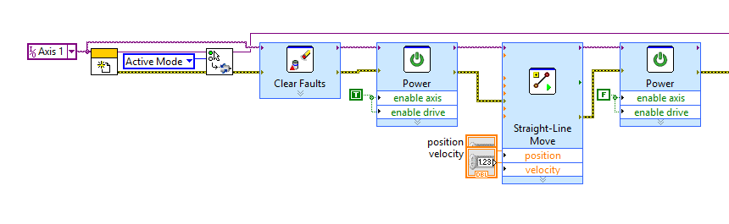
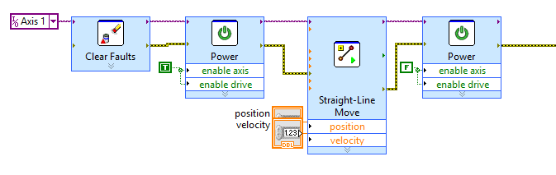
Getting Started.vi
Notes:
When creating a plug-in Getting Started.vi will be created along with the actual plug-in code. This screenshot is from that VI.
The important things is that the plug-in’s Open.vi and then ‘SoftMotion Set Plugin Mode.vi’ must be called before doing anything with the plug-in axis.
A side effect of this is that the Interactive panel from the LabVIEW project will not work until the VI is running. Creating a startup executable on RT with calls to these two Vis will make it function as any other SoftMotion Axis.

Slide 19
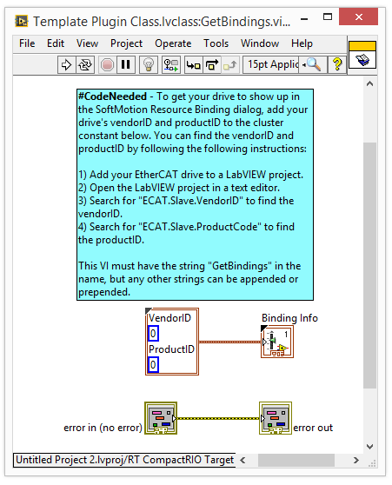
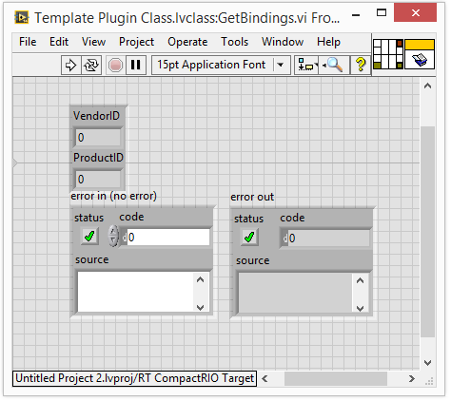
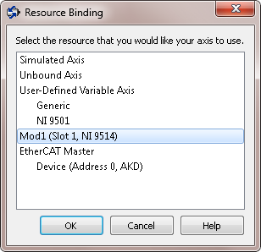
Get Bindings.vi
Notes:
This is the get bindings VI. It is very simple because all it does is return two numerics. But they are important numerics. The Vendor ID and Product ID will allow SoftMotion to identify your drive as bindable hardware when it is an EtherCAT slave in the LabVIEW project. This is the first VI to modify after creating the plug-in.

Slide 20
Plug-in base class Overridables for customization
Customize where needed for additional features or deviations from the DS402 Specification.
OnTransitionToConfigMode.vi
OnTransitionToActiveMode.vi
Initialize.vi
Execute.vi
SetProperty.vi
GetProperty.vi
ErrorHandler.vi
Cleanup.vi
Property Accessor Methods
Notes:
Many overridable VIs in the base class (nismPluginAxisBaseClass.lvclass) that can modify the behavior of the plug-in. The plug-in documentation gives more details on when you would want to override each one.

Slide 21
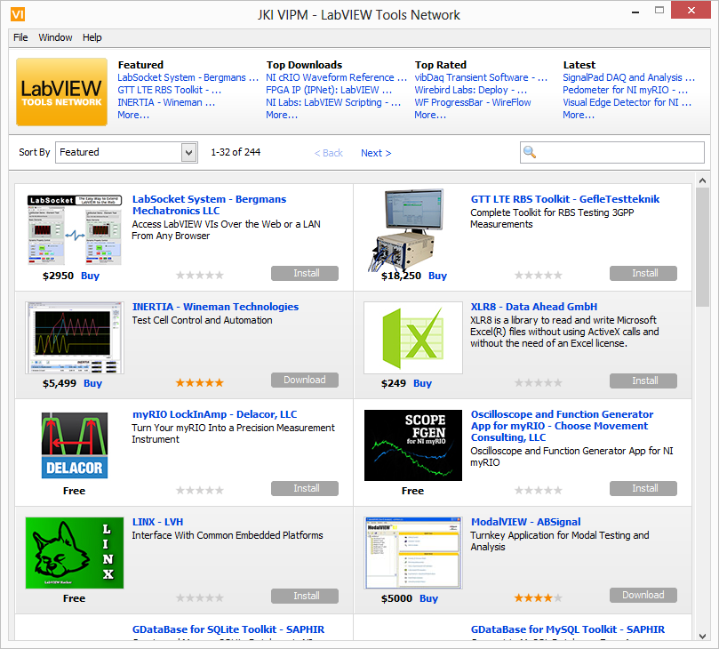
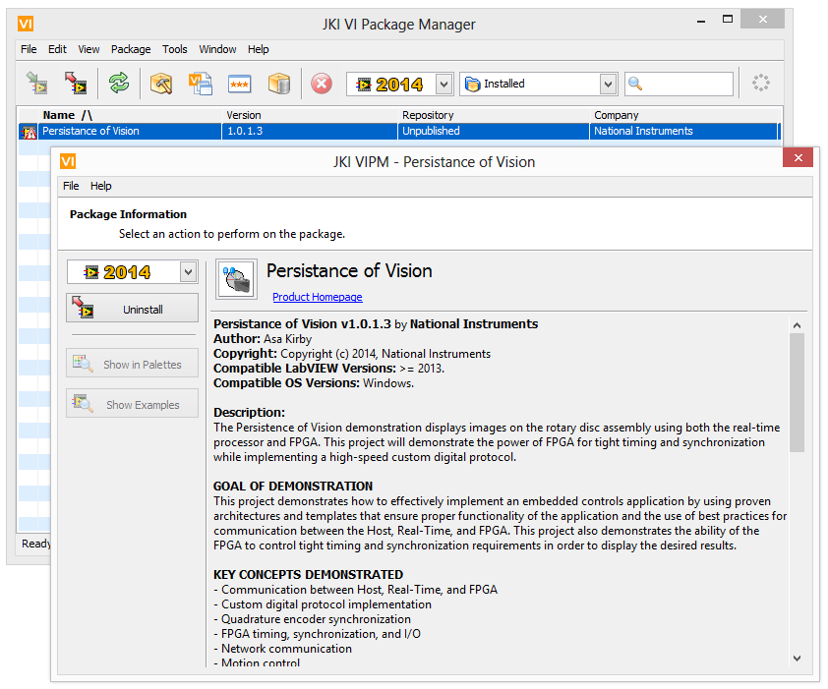
SDI Distribution Method
Notes:
The LabVIEW Tools Network will host SDI Plug-ins for our drive partners. Customers can visit the Tools Network to download and install these Plug-ins, enabling native SoftMotion support for their preferred EtherCAT drive. They can be confident in the function of these Plug-ins because a SDI certification process will ensure the Plug-in has been tested for common customer use cases.

Slide 22
SDI Distribution Method
LabVIEW Tools Network
Easy customer access and installation
Visibility to potential customers
VI Package Manager to create the redistributable
SDI Plug-in VIs
Examples
Menu file with reference to Open.VI
Drive Specific files
Device Profile
Drive and/or Plug-in specific Documentation
License Agreement, Etc.
Notes:
The LabVIEW tools network is the preferred distribution method for SDI plug-ins. The advantages are many. It is very easy for customers to download and install the plug-in. It is visible to potential customers. It will be a visible part of the SoftMotion Drive Network. The LabVIEW Tools Network is how NI distributes much of our demo code now.
See here for details on how to get your plug-in on the tools network: https://decibel.ni.com/content/groups/labview-add-on-dev-center
For creating the distributable: https://decibel.ni.com/content/docs/DOC-18062

Slide 23
Expected development workflow
Setup
Development
Distribution
Setup Hardware
Create Template
Create VI Package
Install Device Profile through
NI-EtherCAT
Update Get Bindings.vi and bind axis to drive
Submit to LabVIEW Tools Network
Add drive to LV project and test with NI-EtherCAT
Test and Modify
Notes:
Setup:
If a device profile .xml file is available, the setup phase should take less than 5 minutes after setting up the hardware.
Development:
Creation of the template will take less than 5 minutes.
Updating the Get Bindings.vi and axis binding will be a few mouse clicks and some data retrieval.
Testing and Modifying will be the main body of SDO linking and working around any non-DS-402 behavior.
Distribution:
Creation of a VI Package takes about 20 minutes using a guide.
Submission to LV Tools Network is quick, but acceptance can take up to a month. Prior testing and certification steps for the SDI Plug-in will reduce this time.

Slide 24
Initial and ongoing effort
Initial Development ~ 4 weeks
We have integrators that can consult and own SDI Plug-ins if needed
Requires testing on 2 drives wired up and ready to go
LabVIEW, EtherCAT, and target drive experience will help
DS402 compliance also helps
Support
NI support will handle general SoftMotion questions
Plug-in implementer is responsible for maintaining plug-in
i.e drive firmware updates, yearly LabVIEW updates
Notes:
We expect development to take approximately 4 weeks for someone inexperienced with the SoftMotion Drive Interface Framework and Plug-in template. NI has preferred integrators with SDI experience that can develop, own, and update SDI Plug-ins for drive partners that see larger than desirable investments in time and hardware.

Slide 25
Drive Partner Promotion – SDI Benefits
NI plans to promote this partnership
NI Week (5000+ attendees yearly, and growing)
NI Days (25-30 expositions worldwide)
Trade show demonstrations
Online – Drive Partner Network and LabVIEW Tools Network
Case Studies
Demo collaboration
Where else could NI promote you as a drive partner?

